Slide 1
ZOO RACER
logo

Slide 2
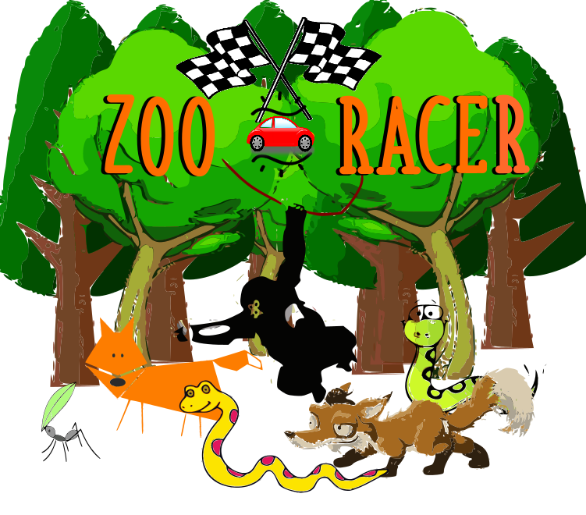

Slide 3
What is zoo racer?
“ZOO RACER” is the maze racing game using logo code with some attractive character to play, such as animal.
It contain a lot of leves, when you move to others level the maze gonna be more harder.

Slide 4
How to play zoo racer?
First, you should aim the position you want, by typing or commanding in maximum 90 degrees
Second, measure the the position you want to move by typing the “forward or backward”
And the last, continue the game until finished.

